Slide 1
Storage Types
Storage Fundamentals
Fiber channel
Direct attached Storage
Network Attached Storage
Storage Area Network
Raid
Raid Levels
Raid 0 Raid 1
Raid 2 Raid 3
Raid 5 Raid 9
Raid 10

Slide 2
Normalization
Normalization Form
1NF
2NF
3NF
BCNF

Slide 3
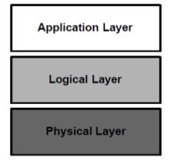
SQL
DATA TYPES
DDL - Create, Alter, Rename, Truncate, Drop
DCL - Insert, Delete, Update, Select
DML - Grant, Revoke
TCL - Commit, Rollback
General RDBMS Architecture

Slide 4
EF Codd Rules
Information Presentation
Granted Access
Systematic Treatment of Null Values
Dynamic Online Catalog
Comprehensive Data Sublanguage
View Updating
High Level Insert, Update, Delete
Physical Data Independence
Logical Data Independence
Integrity Independence
Distribution Independence
Non-Subversion Rule

